Slide 1


Building Communities
Seiriol
Notes:
The Building Communities Project centres on community visioning exercises in the Seiriol Ward of Anglesey. The project is actively engaging with communities to get them more involved in shaping how they want services to be delivered in their area and looking at alternative methods of delivery in the current economic climate.
The joined up or co-productive way of working is highlighted a key priority for the partners involved and is a common aim for the statutory , public and third sector organisations who are facilitating the process on Anglesey.
Partners to this particular visioning process include the Local Service Board, Ynys Mon Council, Gwrandwch Community Voice, and Age Cymru.

Slide 2
Aims: What Are We Trying to Do?
Prioritising open and transparent discussions between communities and service providers.
Adjusting the shift in balance between individuals and providers and creating equal partnerships.
Establishing communities as the experts in identifying what is important to them.
To create a structure for engagement that could be used again and again in different communities.
To create a Vision for Seiriol that reflected the needs and priorities of ALL sectors of the community.
Notes:
The project was commissioned by Anglesey Council as a new and more transparent approach to its transformation of adult services. The idea behind the community visioning process as a co-productive approach enabled the County Council to work with the LSB, Third Sector and the community to open honest and transparent discussions about how services were going to be delivered in the future. To remove potential negative barriers to engagement the project was fronted by the Local Service Board and it was felt that this would also provide communities with a greater understanding of the role of LSB’S.
In carrying out the visioning process we wanted to find out from the local people what they already had within their communities, what they felt they needed in communities and to open conversations about how we were going to achieve this. This included the element of talking tom communities about building their capacity and knowledge to develop and take responsibilities forsome of the activities that they saw as priorities and therefore giving them an equal seat around the table in discussions about how those activities should be delivered.
The process acknowledges that communities are experts in identifying what is most important to them and that this should form the basis of service design and delivery as a more efficient and effective way of meeting real needs. The process would also create a model for engagement that the group could then move into other parts of the Island to discuss the different priorities, needs and assets of other communities- enabling a more comfortable way for people to engage and also to provide services with accurate and relevant information upon which to build their services.
Above all the main aim for this initial process was to create a vision for Seiriol which reflected the needs and priorities of all sectors within that geographical community.

Slide 3
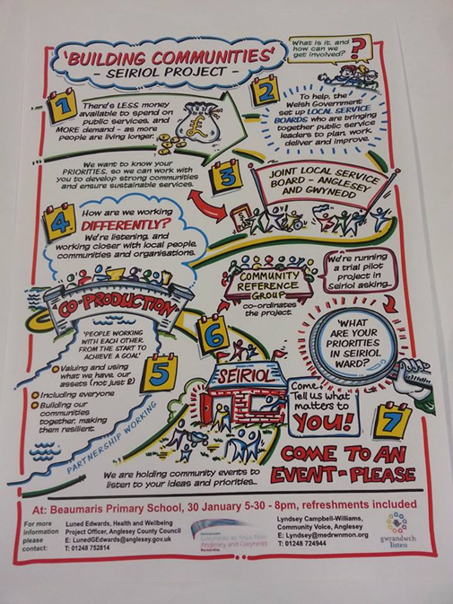
Process: How Are we going to do it?
Initial discussions- YMCC, LSB, MTC and Lleisiau Lleol
Bring a Friend- informal session
Wider stakeholder discussion- who is already working in the area?
Poster- easy read visioning process
Letter from LSB- using community contacts to identify potential interested community members
Event- Beaumaris School
Notes:
Discussions about the Community Visioning process and a potential joined up approach began almost a year ago and started with a small steering group of organisations including Medrwn Mon through Making the Connections and Lleisiau Lleol, the County Council and the LSB. The group was conscious that they needed to communicate the visioning idea to communities in an effective and engaging way, using the resources that we already had within our communities and natural networks to spread the word.
The group commissioned Fran O’hara to facilitate a wider stakeholder meeting, where a number of organisations were invited to attend to identify who we had around the table and who we were missing. We then decided when and where the initial meeting was going to be held and what is should look like.
The initial meeting would introduce the idea of co-production to communities and so we had to be clear about how people were invited. We used a two-fold approach in directly contacting people by letter inviting them to the meeting- these people were identified through the wider stakeholder group as individuals who were active within their communities. We then followed this up with the Building Communities Seiriol project poster- explaining the reasons behind the meeting and what we were trying to achieve.
We highlighted that he meeting would be an informal session, asking people to bring along anyone else they thought would be interested.

Slide 4
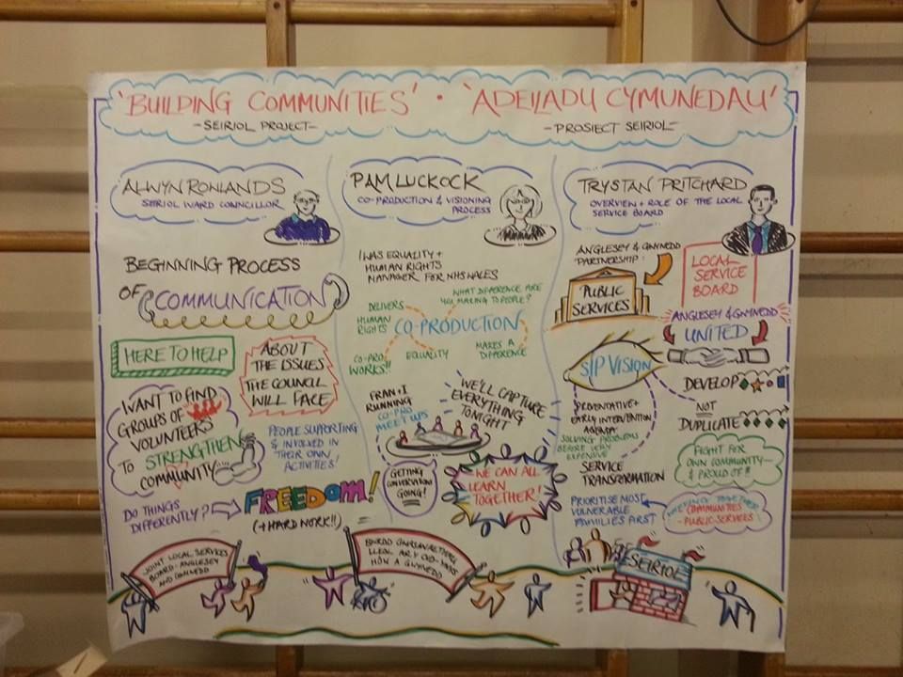
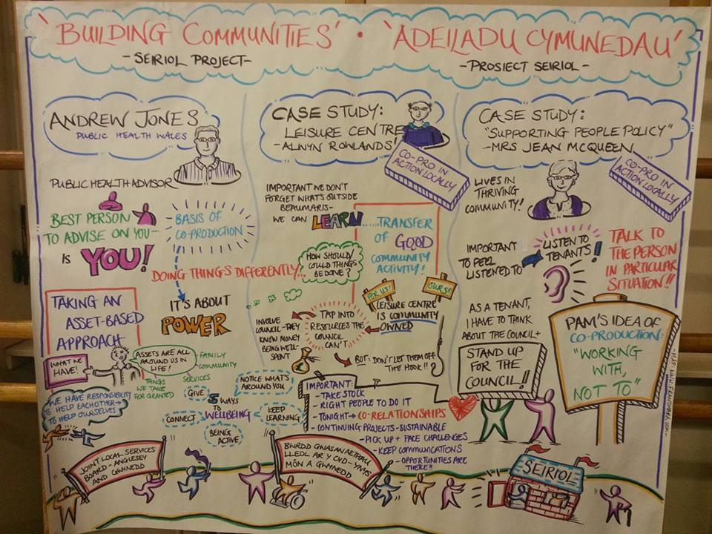
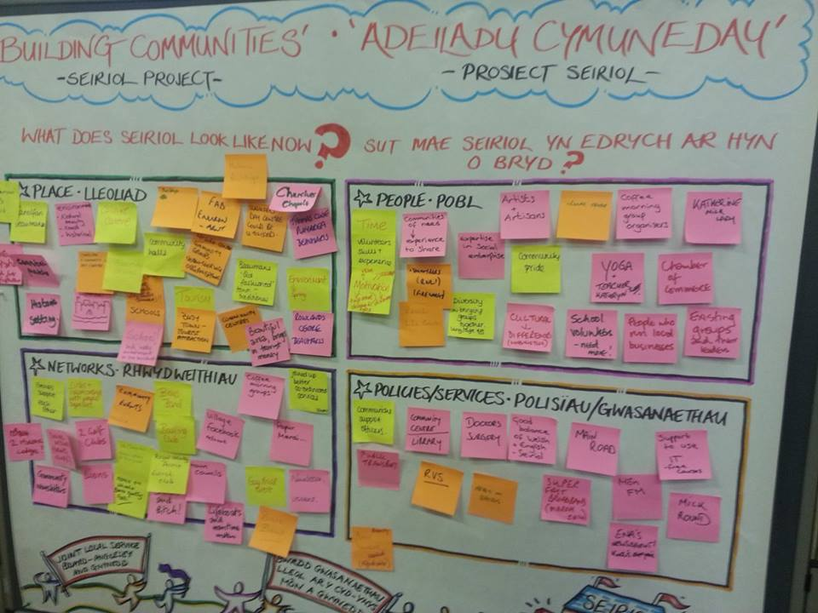
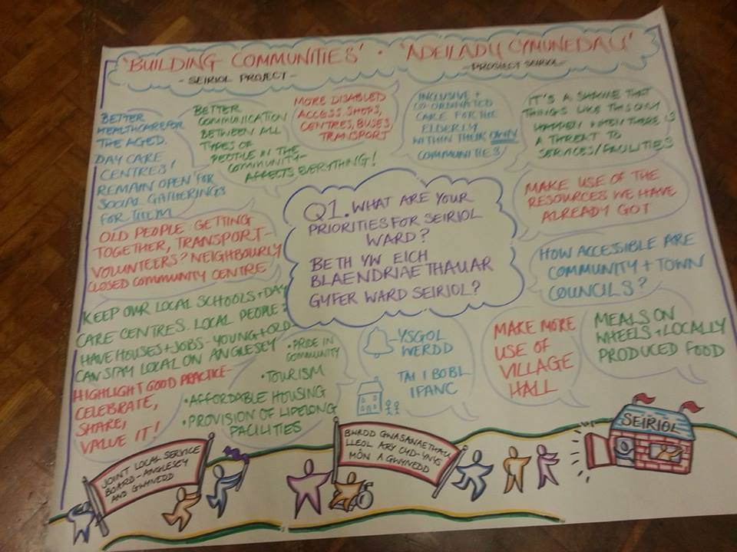
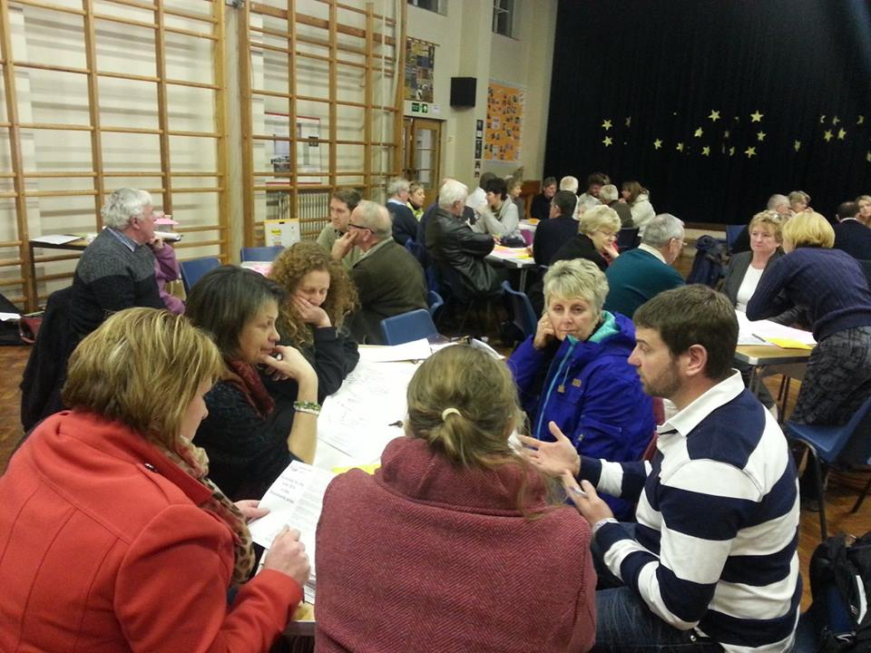
Seiriol Event
Notes:
The event was held on a Weds evening between 5.30 and 8.30pm in Beaumaris school- the choice of venue was important in that it need to bring people from all geographical areas within the ward together in an informal environment not linked directly to one group within a given community. Food was provided and the layout of tables etc was made as comfortable as possible for people to engage and interact with the workshop sessions.
Guest speakers introduced the topic of co-production and visioning highlighting that this was a positive event looking at identifying the assets within the community and how people could work together to prioritise the issues and services they felt were the most important to consider. The exercises helped to highlight all the activity already going on in the communities and made reference to just how much work is already being done by services, the third sector and community residents.
Following on from these initial discussions we asked who were interested to sign up to become part of a reference group who would then work to move the priorities forward in to smaller task groups representing an individual theme- environement, transport, etc

Slide 5
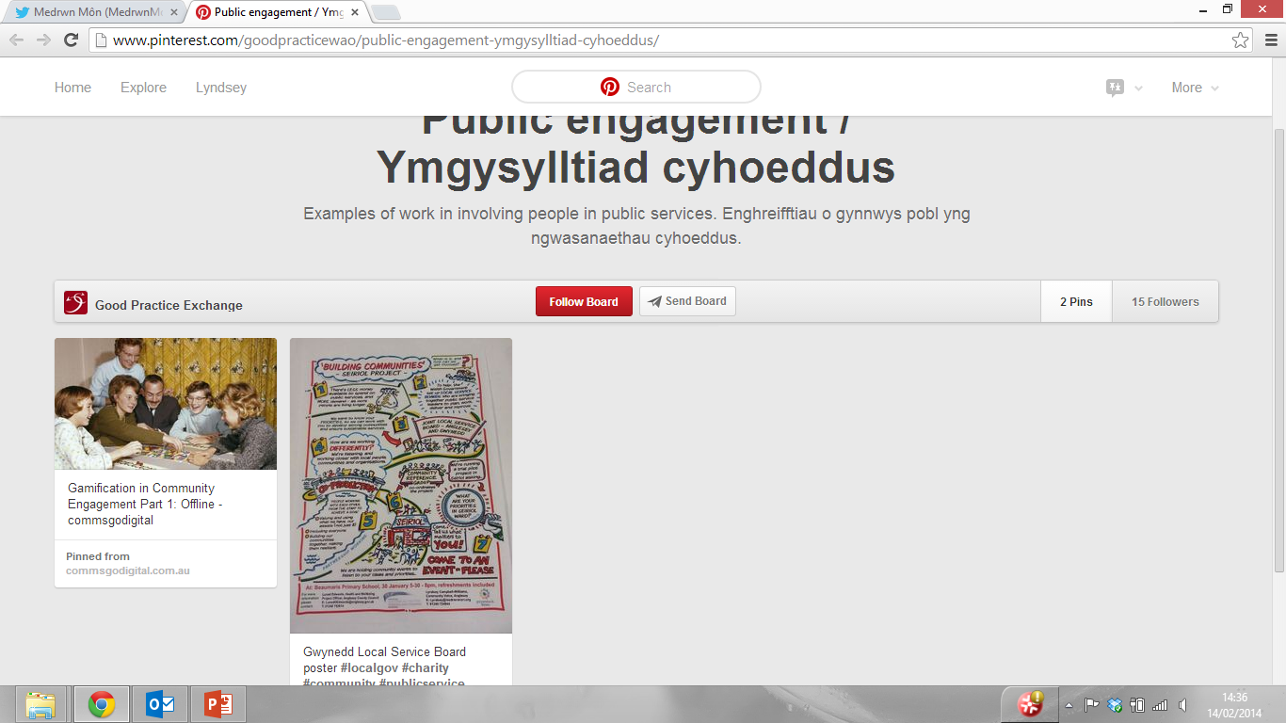
Feedback & Next Steps
Evaluate the event- lessons learned and feed back.
Establish Reference Group to look at the priorities identified.
Create action plan and establish task groups Role out the model in other areas of the Island.
Share best practice along the way.
Notes:
The steering group is now preparing the feedback from the visioning event 2 weeks ago and is planning to meet with the individuals who put their names down for the reference group mid-march. Overall feedback has been very positive from the community and also from outside organisations- the poster was retweeted by the Wales Audit Office and pinned to their pinterest board as an example of good practice in community engagement models!
As already stated we are now looking at establishing the reference group and building their capacity to engage with the groups within the community that we didn’t see at the event, to identify the priorities and to plan and deliver services through the co-production model.
We are only very early on in the visioning process and are already learning lessons and adapting as we go- the overall aim is to have an effective but flexible model that can be shared as best practice across other areas of the Island and to create a solid framework of joined up working within the community, third and public sector.

